Slide 1
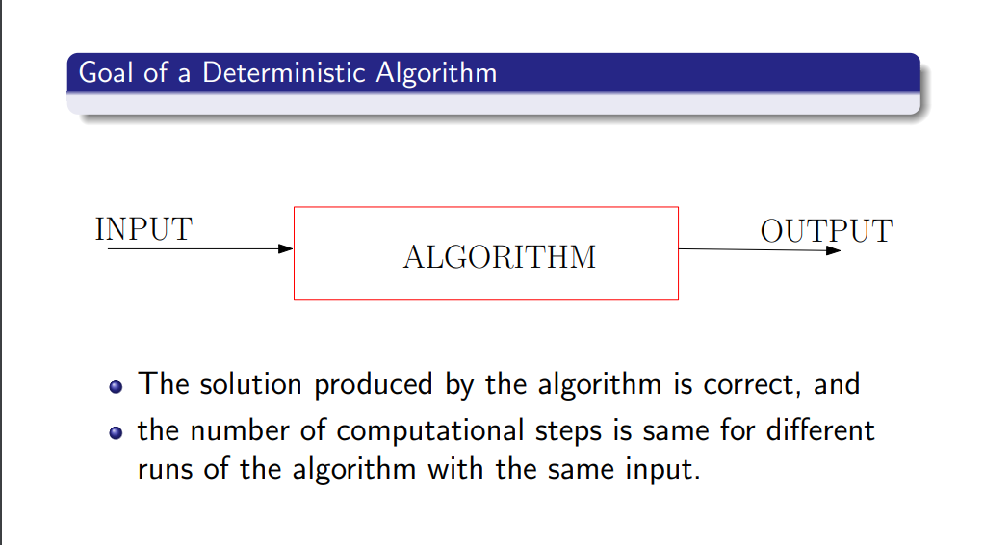
Randomized Algorithms and Randomized Data Structures

Slide 2
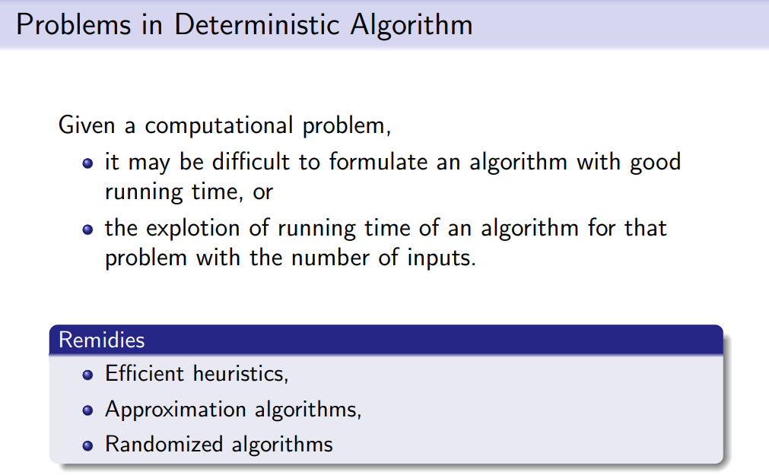
Randomized Algorithms and Randomized Data Structures

Slide 3
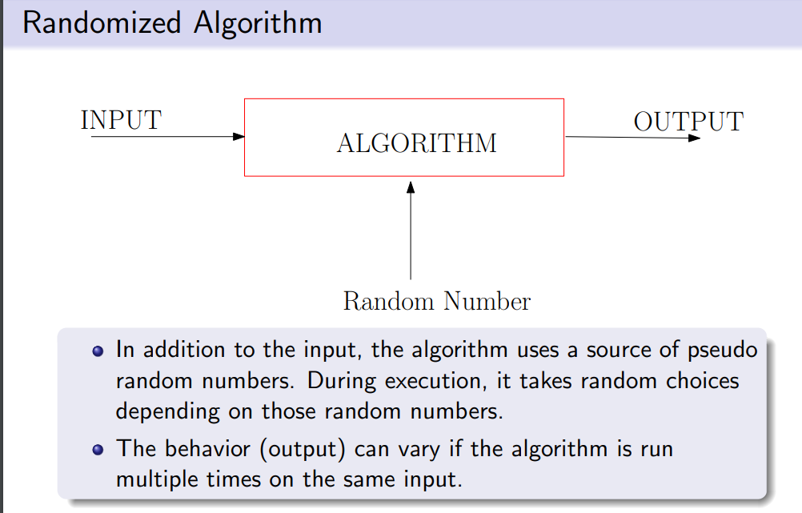
Randomized Algorithms and Randomized Data Structures

Slide 4
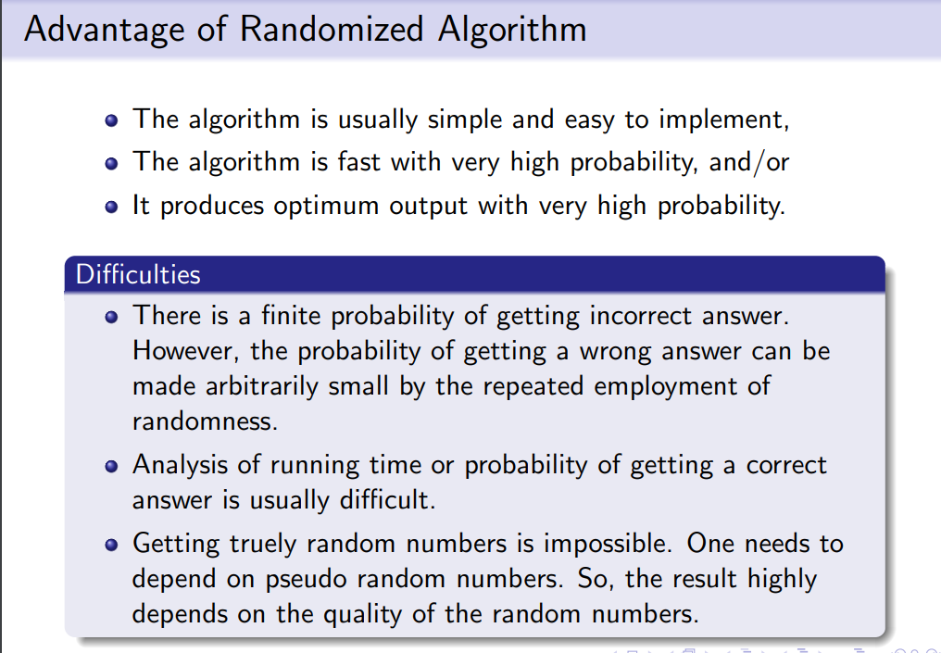
Randomized Algorithms and Randomized Data Structures

Slide 5
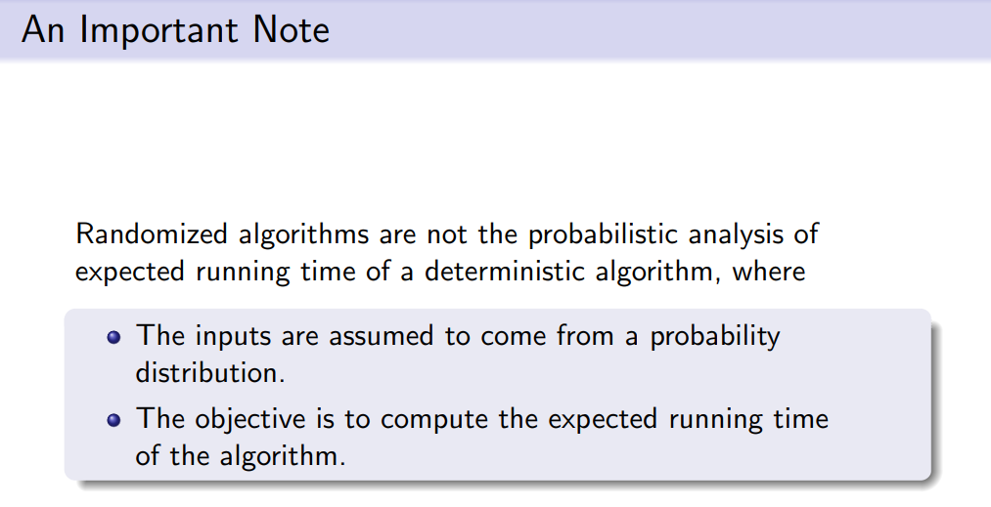
Randomized Algorithms and Randomized Data Structures

Slide 6
Randomized Algorithms and Randomized Data Structures
A randomized algorithm is an algorithm that can make decisions based on the outcomes of random events (“coin flips”).
There are two principal advantages to randomized algorithms:
The first advantage is performance; randomized algorithms run faster than the best-known deterministic algorithms for many problems.
The second advantage is that many randomized algorithms are simpler to describe and implement than deterministic algorithms of comparable performance.

Slide 7
Randomized Algorithms
Randomized algorithms come in two main types:
Las Vegas: A Las Vegas algorithm is guaranteed to be correct, but the runtime is a random variable. With a Las Vegas algorithm we want to bound the expected runtime or show that it is small with high probability.
Monte Carlo: A Monte Carlo algorithm has a fixed runtime but may give incorrect results with some probability. With Monte Carlo algorithms we want to achieve a low runtime as well as bound the probability that the algorithm outputs an incorrect answer.

Slide 8
Randomized Algorithms
Analyzing Randomized Algorithms-
Types of Randomized Algorithms Typically one encounters the following types:
(A) Las Vegas randomized algorithms: for a given input x output of algorithm is always correct but the running time is a random variable. In this case we are interested in analyzing the expected running time.
(B) Monte Carlo randomized algorithms: for a given input x the running time is deterministic but the output is random; correct with some probability. In this case we are interested in analyzing the probability of the correct output (and also the running time).
(C) Algorithms whose running time and output may both be random.

Slide 9
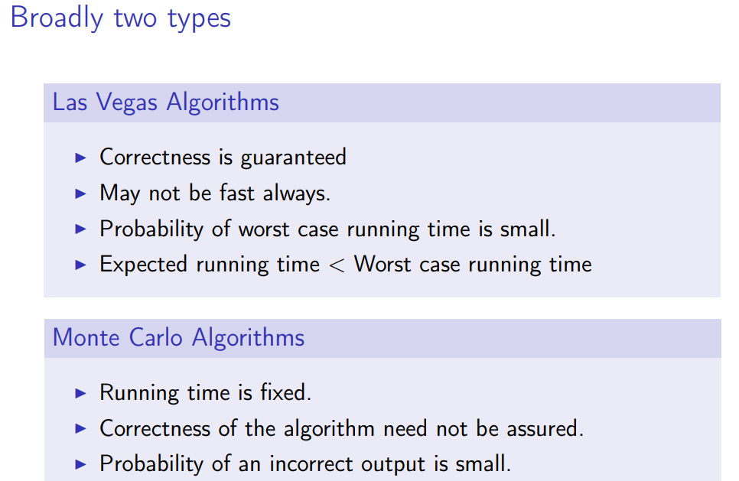
Randomized Algorithms

Slide 10
Randomized Quick Sort Algorithms
Quick Sort:
This is an in-place sort algorithm that uses the divide and conquer paradigm.
It picks an element from the array (the pivot) and partitions the remaining elements about the pivot. The elements are partitioned into those greater than and those less than this pivot.
The algorithm afterwards recursively sorts the partitions.
Quick sort has a worst-case running time of O(n²), but typically it runs in time O(n log n). Figure 2 illustrates the quick sort algorithm.

Slide 11
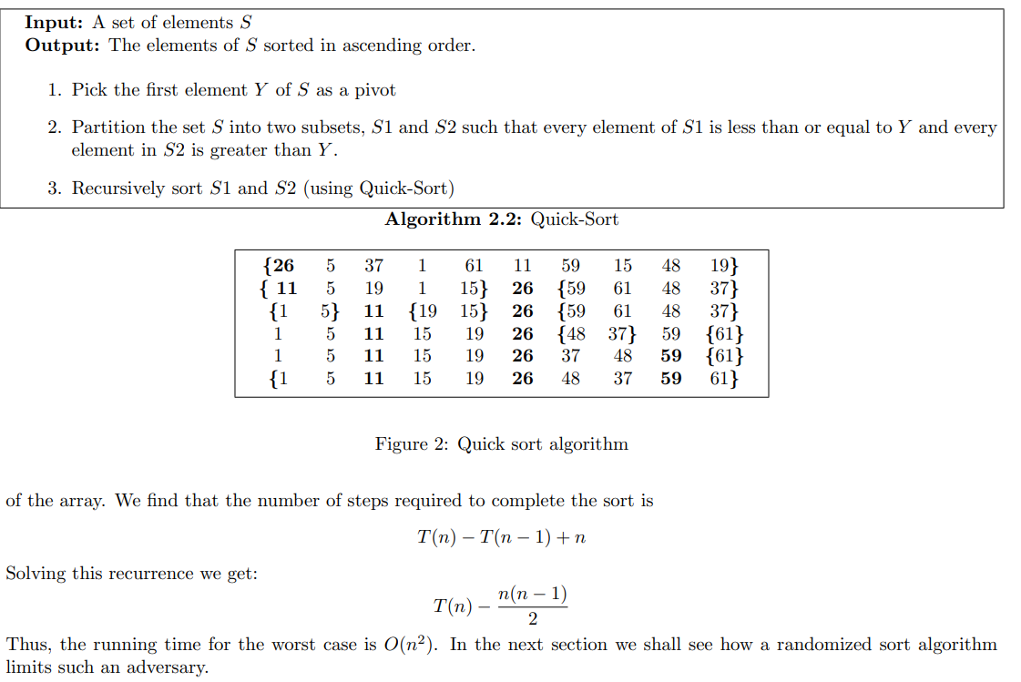
Randomized Quick Sort Algorithms
Quick Sort:

Slide 12
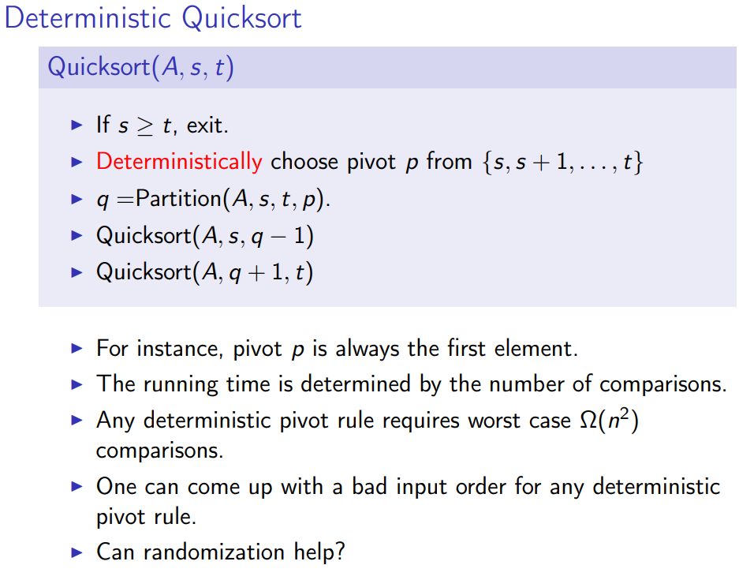
Randomized Quick Sort Algorithms

Slide 13
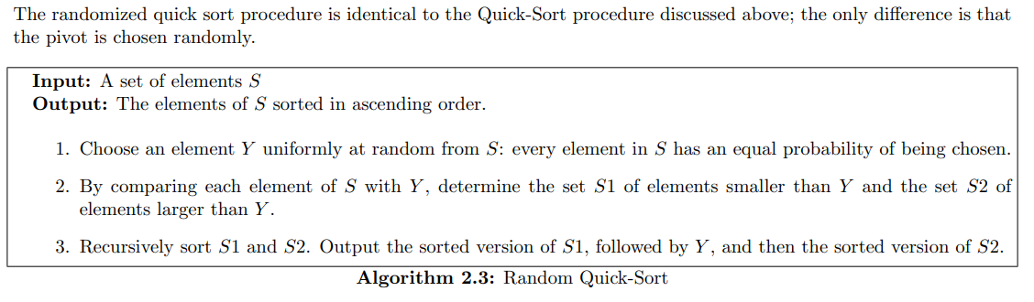
Randomized Quick Sort Algorithms
Randomized Quick Sort:

Slide 14
Randomized Quick Sort Algorithms
Randomized Quick Sort:
As usual for sorting algorithms, we measure the running time of the random quick sort in terms of the number of comparisons it performs since this is the dominant cost in any reasonable implementation.
For this randomized version, we are interested in the expected number of comparisons in an execution of this algorithm.

Slide 15

Randomized Quick Sort Algorithms
Note that all the comparisons are performed in Step 2, in which we compare a randomly chosen partitioning element to the remaining elements.
For 1 < i < n, let S(i) denote the element of rank i (smallest element) in the set S. Define the random variable X_{ij} to assume the value 1 if S(i)and S(j) are compared in an execution, and the value 0 otherwise.
Thus, X_{ij} is a count of comparisons between S(i) and S(j). It should be noted that two different elements are only compared once, that means comparing S(i) with S(j) is the same event as comparing S(j) with S(i). Thus, X_{ij} = X_{ji} and so the total number of comparisons is

Slide 16
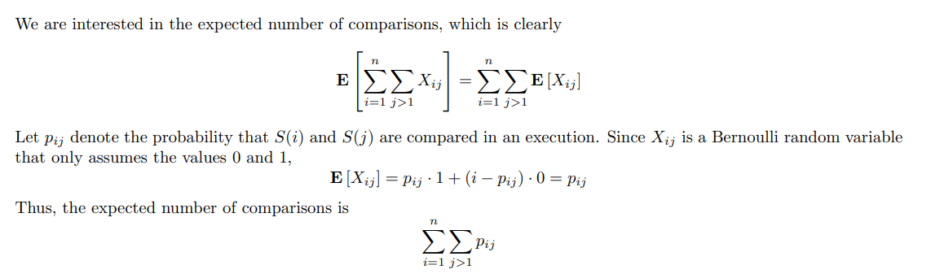
Randomized Quick Sort Algorithms
Randomized Quick Sort:

Slide 17
Randomized Quick Sort Algorithms
Randomized Quick Sort:
To facilitate the determination of p_{ij} one can view the execution of the algorithm as a binary tree T, each node of which is labeled with a distinct element of S.
The root or the tree is labeled with the element Y chosen in Step 1.
the left sub-tree of Y contains the elements in S1, and the right sub-tree of Y contains the elements in S2.
The structures of the two sub-trees are determined recursively by the executions of the random quick sort algorithm on S1, and S2.

Slide 18
Randomized Quick Sort Algorithms
Randomized Quick Sort:
The root Y is compared to the elements in the two sub-trees, but no comparison is performed between an element of the left sub-tree and an element of the right sub-tree.
Thus, there is a comparison between S(i) and S(j) if and only if one of these elements is an ancestor of the other.
The output of the algorithm is nothing but the inorder traversal of this randomized binary search tree T.
For the analysis let us consider the level-order traversal of T. The level-order is the permutation π of S obtained by visiting the nodes of T in increasing order of level numbers, and in left-to-right order within each level as illustrated in Figure 3

Slide 19
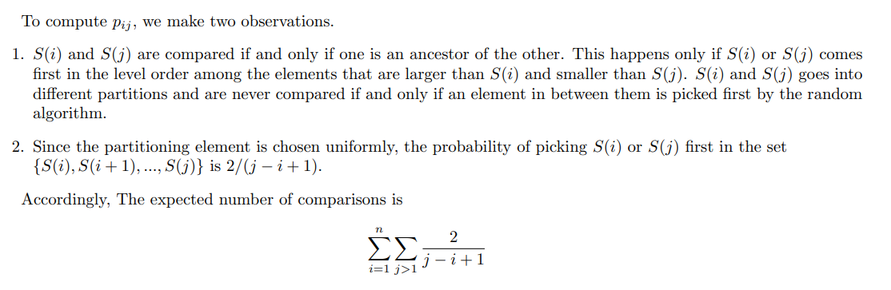
Randomized Quick Sort Algorithms
Randomized Quick Sort:

Slide 20
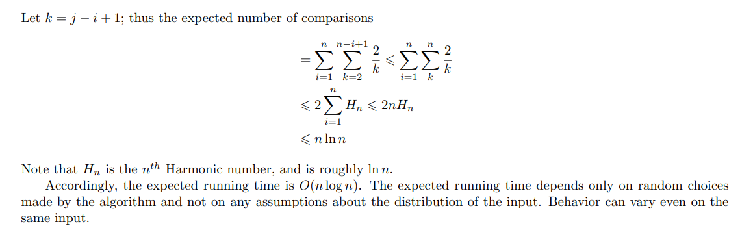
Randomized Quick Sort Algorithms
Randomized Quick Sort:

Slide 21
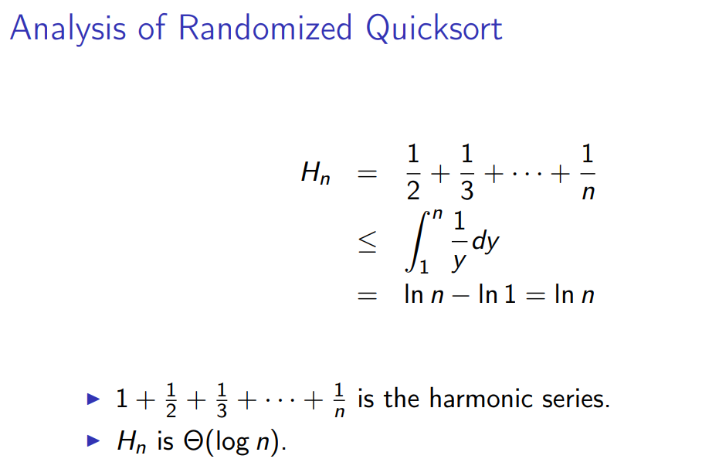
Randomized Quick Sort Algorithms
Randomized Quick Sort:

Slide 22
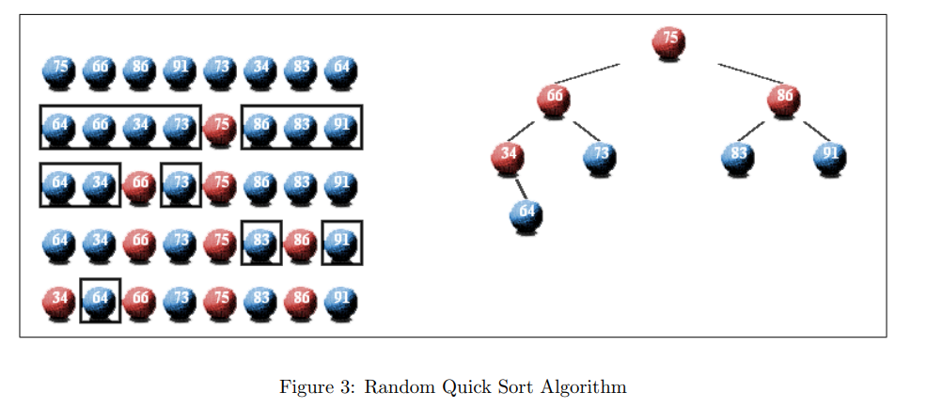
Randomized Quick Sort Algorithms
Randomized Quick Sort:

Slide 23
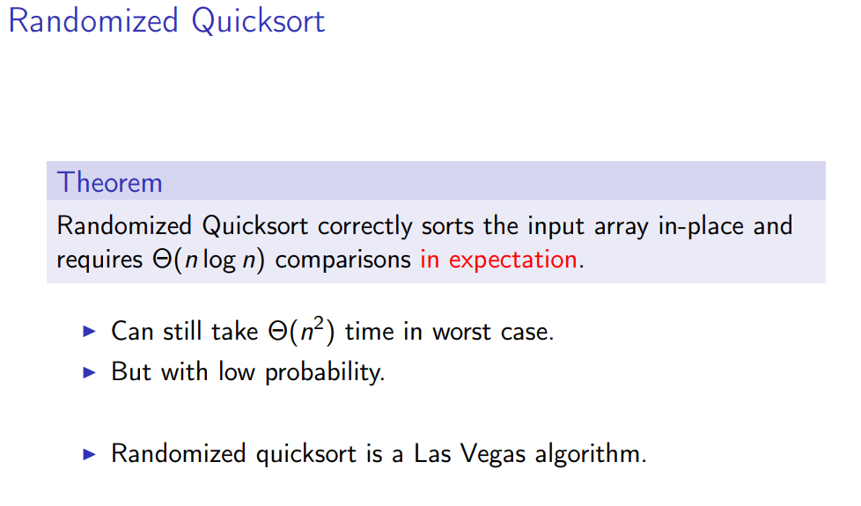
Randomized Quick Sort Algorithms
Randomized Quick Sort:

Slide 24
Randomized Mincut Algorithm
Randomized Quick Sort:

Slide 25
Randomized Quick Sort Algorithms
Randomized Quick Sort:

Slide 26
Randomized Quick Sort Algorithms
Randomized Quick Sort:

Slide 27
Randomized Quick Sort Algorithms
Randomized Quick Sort:

Slide 28
Randomized Algorithms
The domain

Slide 29
Random Variable
The domain

